Slide 1

Price of real estate
Done by: Rui Lameiras mec 102817

Slide 2
What i plan To do?

Slide 3
Why i chose to do it?

Slide 4

Persona
Name: Marco Paulo
Age: 35
Objective: Build a real estate empire in Portugal
Budget: 700000 euros

Slide 5
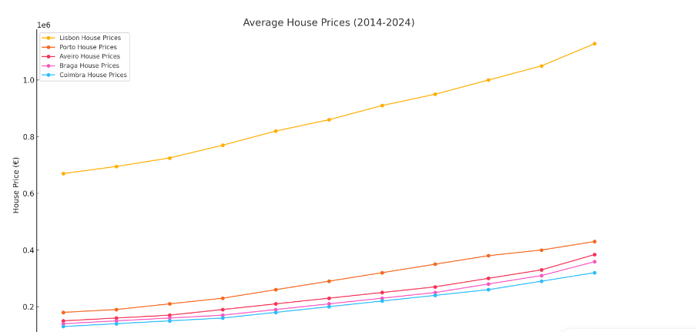

Slide 6
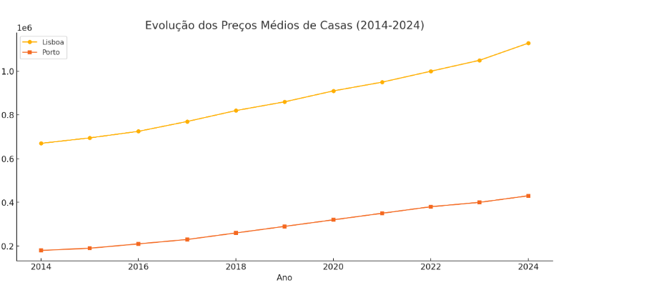

Slide 7
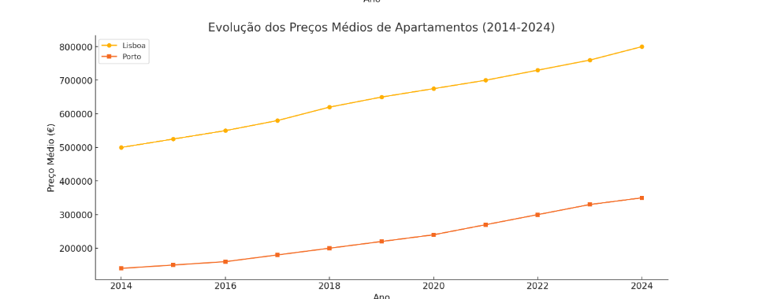

Slide 8
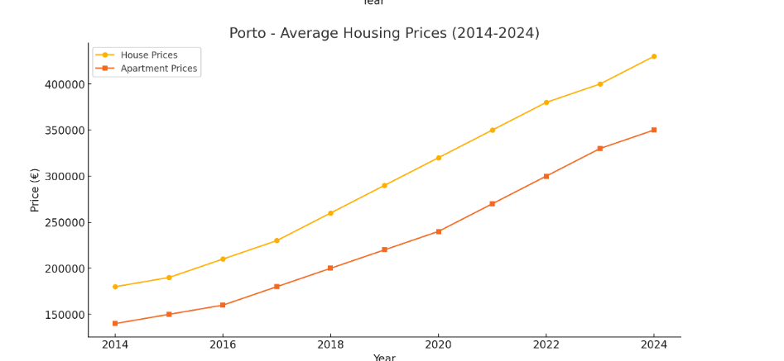

Slide 9
Questions?

Slide 10


